Slide 1
Contact Manager Small Project
Keeping it real while keeping your contacts.

Slide 2
The DB+J’s
Front-End
Jay Adams
David Eyrich (project manager)
Back-End
Jorge Fochezato – Database
Blake Robertson - API
Jacob Thomas - API

Slide 3
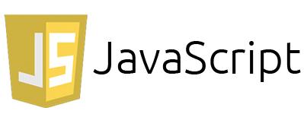



Stacks on Stacks
ME-HCJ-N
MongoDB (database)
Express.js (web framework)
HTML & CSS & JS (Front-End)
Node.js (back-end platform)

Slide 4




Tools
POSTMAN – testing json requests
Jquery – search bar/other element functionality
AWS – server
EC2 instance
Route 53 (DNS area)
GoDaddy – web domain

Slide 5
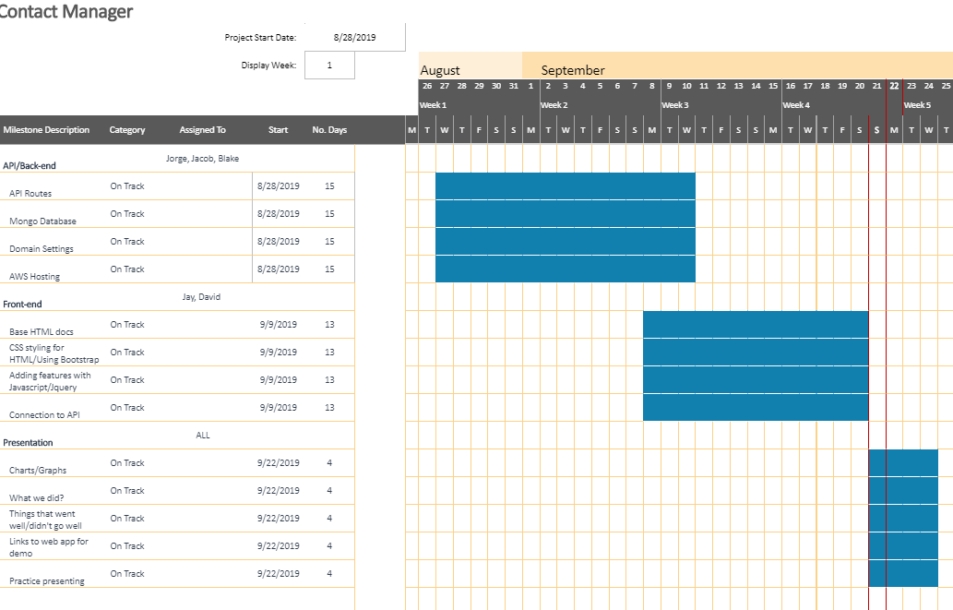
Gantt Chart

Slide 6
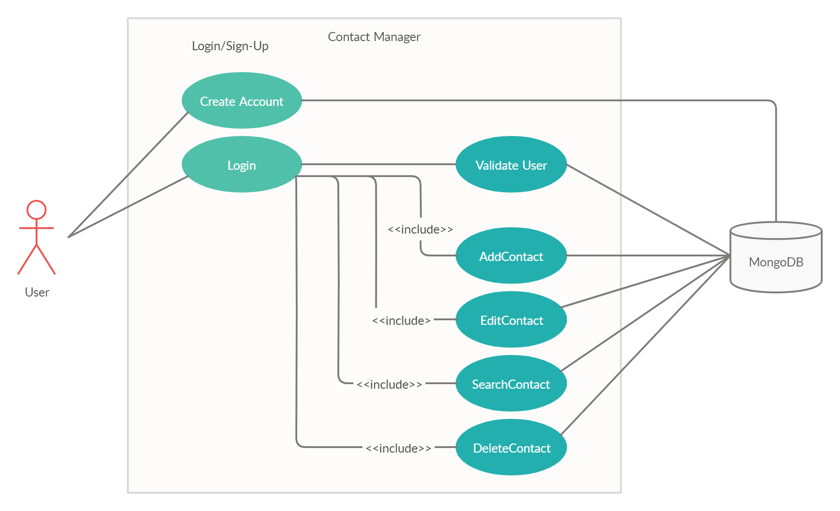
Use Case Diagram

Slide 7
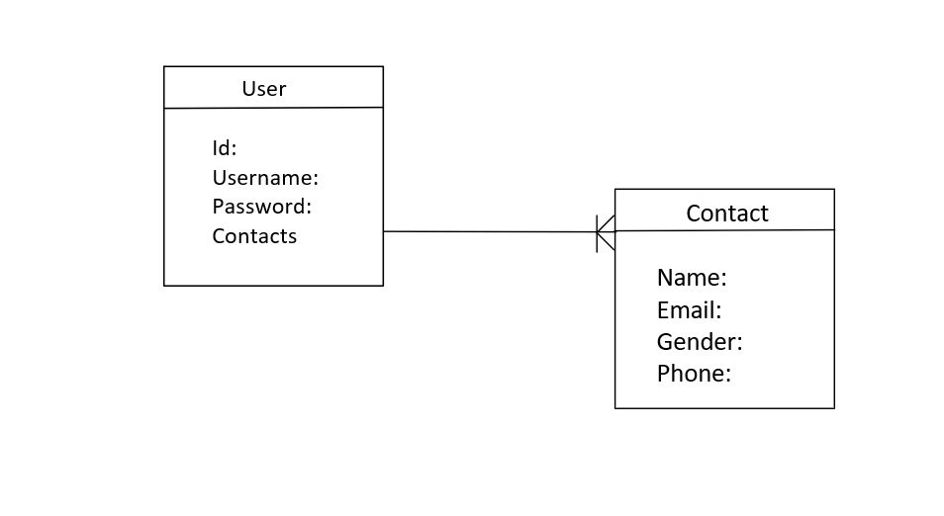
ERD

Slide 8
How did we do it?
Begin with the models for the user and contact in the database and the HTML skeleton
Created basic routes for the website
Made basic json get and post request for the API
Testing the API with the database
Testing the API with the front-end
Merge it all together

Slide 9
What went well? Improvements for the future.
Setup communication very early
Had assigned roles
Semi-Daily Meetups
Working demo before presentation

Slide 10
WhaT Went Wrong? What challenges did we face?
No members had any experience in web development
Should have spent more time on researching
No organized tasks
Difficulties with connecting API with database and front-end
Little to no experience with using GitHub for most members
Implementation of search function

Slide 11
DEMo
Github Link: https://github.com/cosmos1255/DJs
Website Link: http://djscop4331.rocks

Slide 12
Any Questions?

